Slide 1

From Raw Data to Real Insights: A Data Management Approach that Works
Amit Kohli

Slide 2

ACDI/VOCA in Brief
Founded in 1963
501(c)(3) non-profit organization
Total revenues for ACDI/VOCA and Affiliates of approximately $143M
32 active projects in 28 countries
~1,270 current employees
Notes:
Add a picture! ;)

Slide 3

Introduction
LEAP philosophy
How does it look
What it can do
How can you do it?

Slide 4

Data Management Conceptual Framework
- Steph Locke (@SteffLocke)

Slide 5

Data Management Conceptual Framework Options
VALUE
VALUE
PEOPLE
PROCESS
T
O
O
L
S
PEOPLE
PROCESS
TOOLS
MERL THEORY
IT + DATA THEORY
Paper Forms
Technocratic dummy
VALUE
VALUE
PEOPLE
PROCESS
TOOLS
PEOPLE
PROCESS
TOOLS
THEORY?
MERL THEORY + DATA THEORY
External Contractor
System

Slide 6
What is the Learning Evaluation and Analysis Platform (LEAP) specifically?
Philosophy Overview

Slide 7


LEAP Conceptual Framework in Practice
10-day training
Remote support
MERL Policy
Constant Follow-up
Standard Custom db
Standard webpage
Automated reports
VALUE
PEOPLE
PROCESS
TOOLS
THEORY
STOP!
… or I’ll yell “STOP!” again!!!!

Slide 8


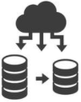



What Does LEAP Do?
FACILITATES PROJECT MANAGEMENT
AUTOMATES REPORTING REQUIREMENTS
AGGREGATE
RAW
PROVIDES STANDARDIZED ASSET MANAGEMENT
EXPOSES DATA

Slide 9
… on Raw Data
MORE IMPACT
WITH A WELL FUNCTIONING RAW DATA MANAGEMENT SYSTEM ☺
WITH NO RAW DATA MANAGEMENT SYSTEM ☹
participants
Trained
Applied Tech
Indicators:
Bens Trained:
- Actual = 5
- Target = 5
- Percent = 100%
Applied Tech:
- Actual = 3
- Target = 5
- Percent = 60%
CHURCH GROUP!
Focus Group
MORE LEARNING
?
Near roads
Insight 1) Just look at the data!
data is not a reporting
obligation,
it’s an opportunity
Not-near roads
Insight 2) Disaggregations
Other disaggs: Age Group? Near Market? Water access? Gender? Local politics?

Slide 10

Can we have another?
I theorize that
A ➔ B. Let me check
Indicators, Monitoring Plan, KPI
Oh well, at least I respected my contract
WITH NO RAW DATA MANAGEMENT SYSTEM ☹
FAIL
FRESH
LOOK
WITH A WELL FUNCTIONING RAW DATA MANAGEMENT SYSTEM ☺
I theorize that
A ➔ B. Let me check
Huh… that’s interesting. I wonder if…
Indicators, Monitoring Plan, KPI
FAIL
THE ACTUAL DATA
ANALYSIS
WINS + LEARNING!!

Slide 11
Data Holdings
Aggregate data
Raw data
Aggregate data in a database
Raw data in a relational database

Slide 12
What Does LEAP Look Like?
Viz Overview

Slide 13



FULL RAW
DATA
APPROACH
AGGREGATE
DATA
APPROACH
checks
PROJECT STAFF
A TON!
SLOW
CUSTOM
RESPONSIBLE
AMOUNT OF DATA
QUERY SPEEDS
REPORT TYPE
HQ STAFF
VERY LITTLE VERY FAST!
STANDARD
TECHNOLOGY

Slide 14



Raw Data flow

Slide 15
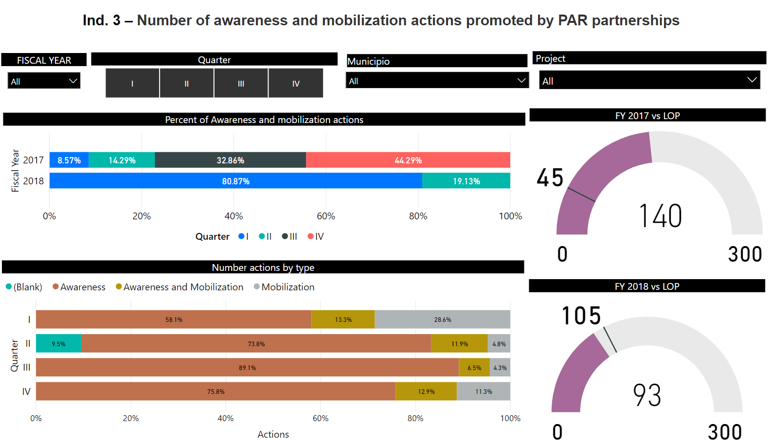
Power BI Dashboards

Slide 16
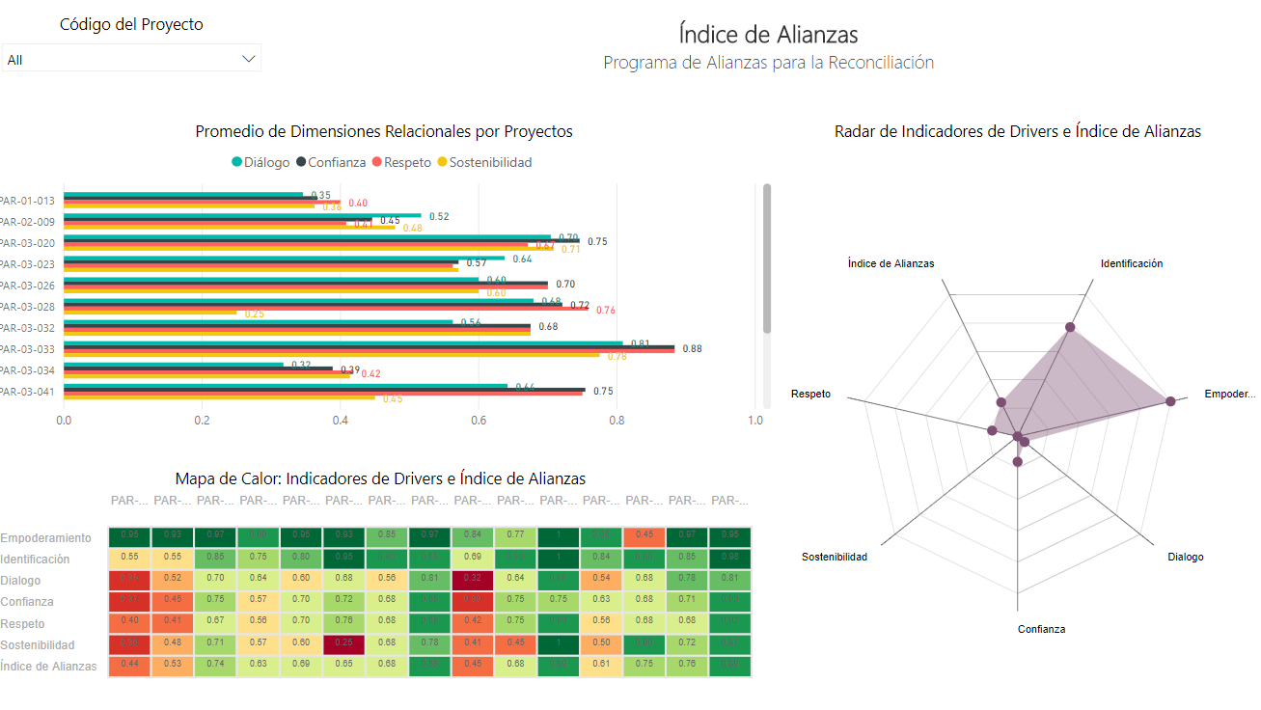
Power BI Dashboards cont

Slide 17
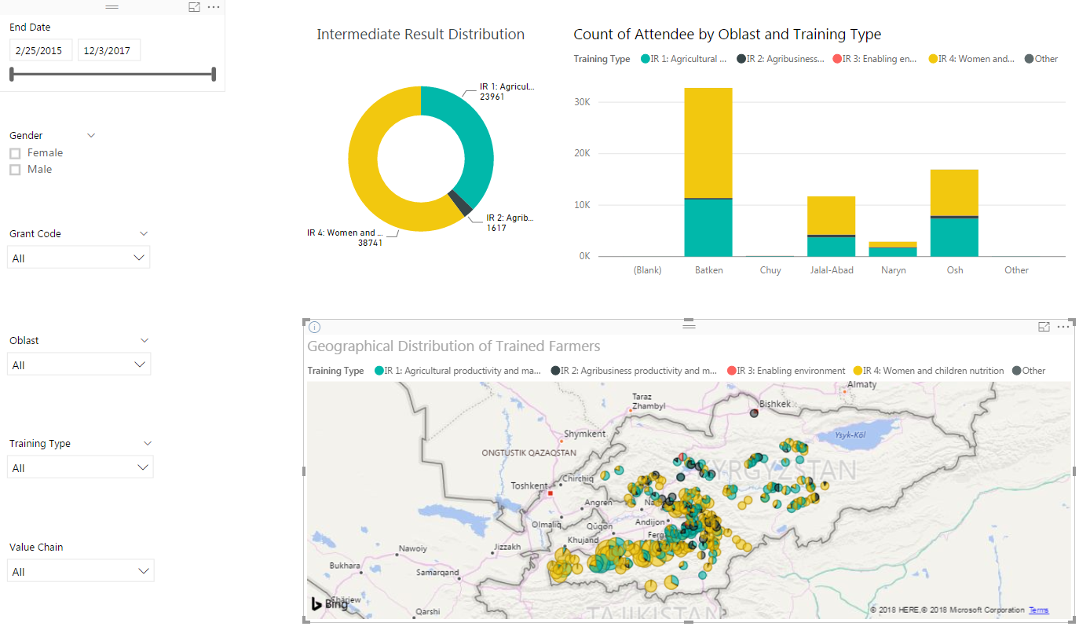
Power BI Dashboards cont

Slide 18
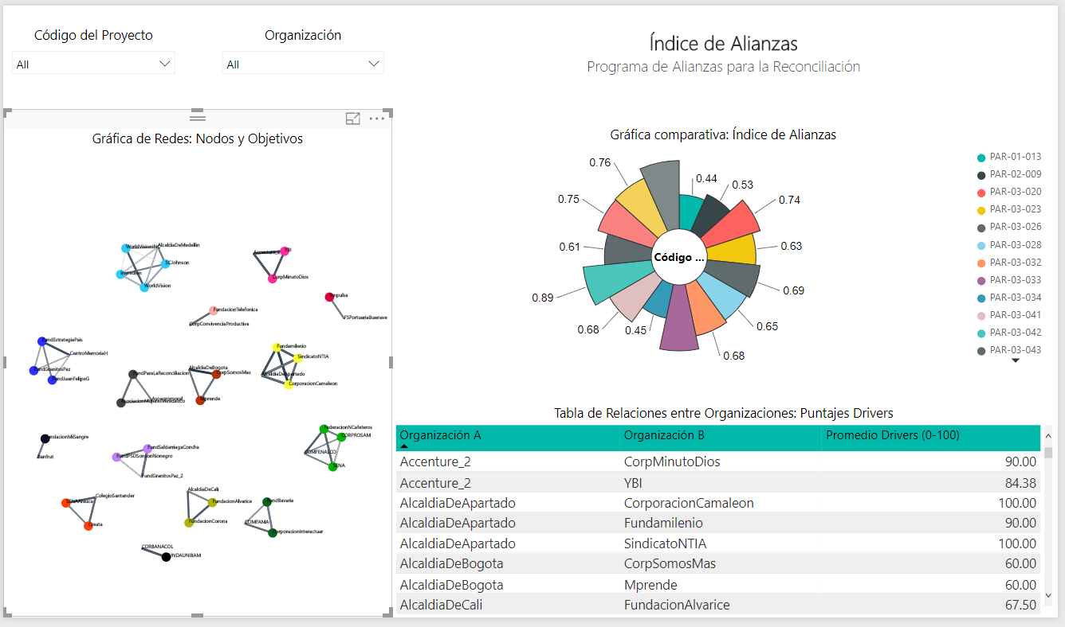
Power BI Dashboards cont

Slide 19
Aggregated Data flow
Automated
Assets
Next Project
Next Project
Next Project
Next Project
15 minute
rounds
ALL ACTUALS
How did run go?

Slide 20
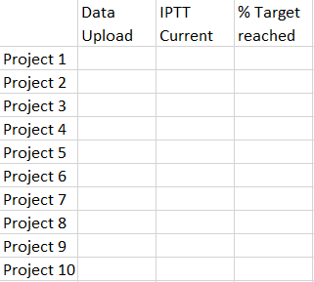
LEAP Automated Assets – Report conceptualization
Data Upload
Data Quality
% Target Reached
Data Upload
Data Quality
% Target Reached
Data Upload
Data Quality
% Target Reached
PROJECT SPECIFIC
TOPIC SPECIFIC
EXECUTIVE OVERVIEW

Slide 21
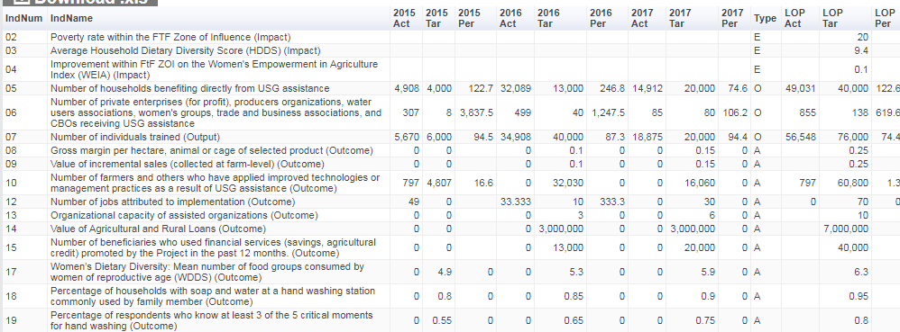
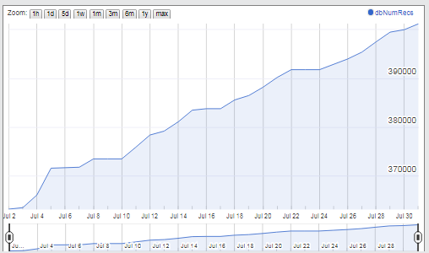
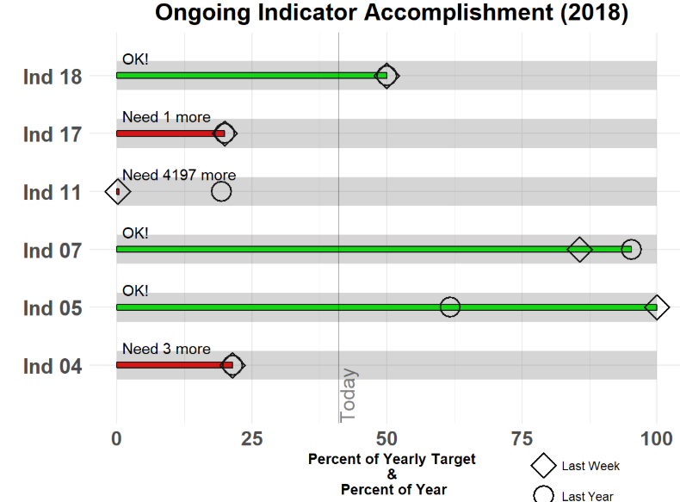
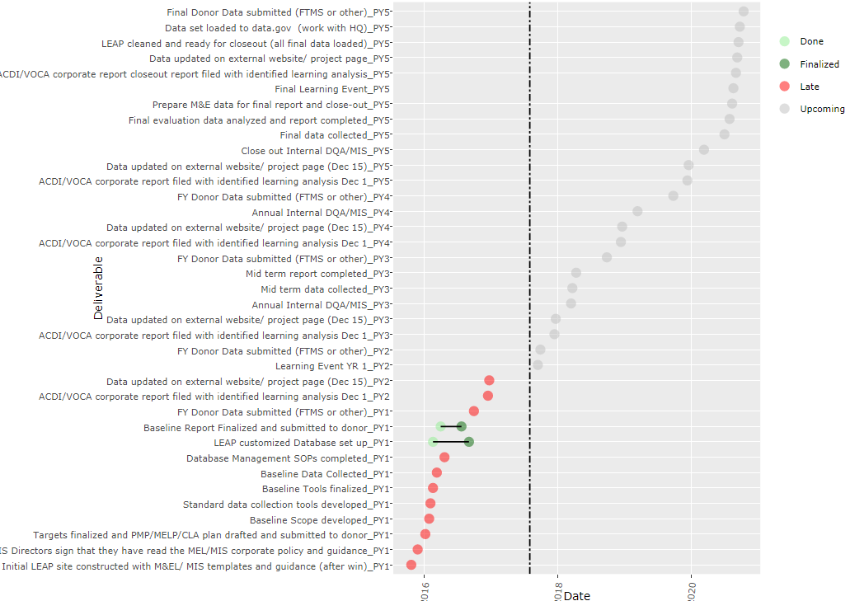
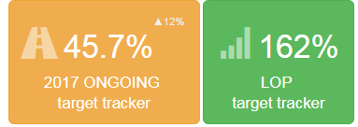
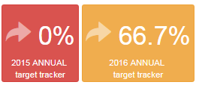
LEAP Automated Assets—Project
Auto-IPTT,
Quarterly Reports
Data
Uploads
Milestone & Action Point Tracker
Indicator
Summaries
Indicator
Performance
http://www.acdivoca.org/2018/03/introducing-the-monitoring-and-evaluation-bullet-chart/

Slide 22
What Types of Awesomeness Does LEAP Allow?
Practical Examples

Slide 23
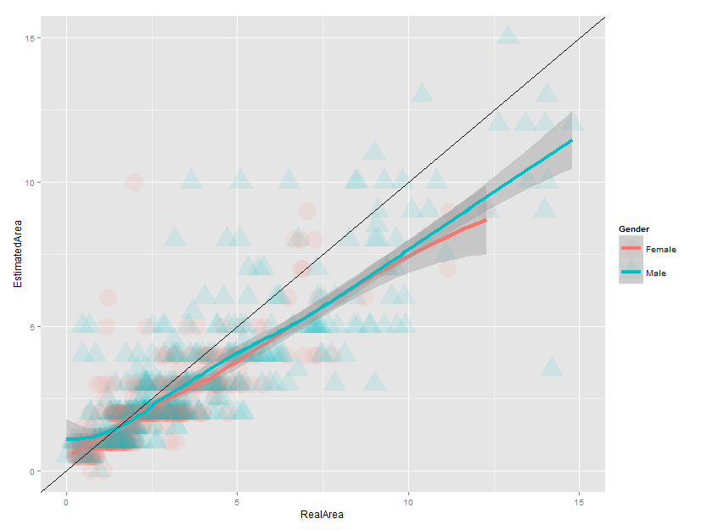
Area assessment by gender -> general miscalculation
Having gender disaggregated area estimates led us to explore estimated areas vs real areas

Slide 24
Household’s assets ownership and usage
Asset | Who owns |  | Who uses
 | Woman or both | Men only | Woman or both | Men only
Power Tiller | 5% | 95% | 37% | 63%
Rotary weeder | 6% | 94% | 40% | 60%
Motorcycle | 9% | 91% | 50% | 50%
Donkey cart | 16% | 84% | 88% | 12%
Tractor | 17% | 83% | 73% | 27%
Traction Animals | 18% | 82% | 78% | 22%
Ripper | 20% | 80% | 63% | 38%
Bicycle | 23% | 77% | 71% | 29%
Land | 25% | 75% | 96% | 4%
Knapsack Sprayer “Solo” | 27% | 73% | 84% | 16%
Thresher | 31% | 69% | 75% | 25%
Ox Cart | 38% | 63% | 70% | 30%
Warehouse to store | 45% | 55% | 98% | 2%
Tarpaulin | 54% | 46% | 94% | 6%
Hoes | 64% | 36% | 96% | 4%

Slide 25
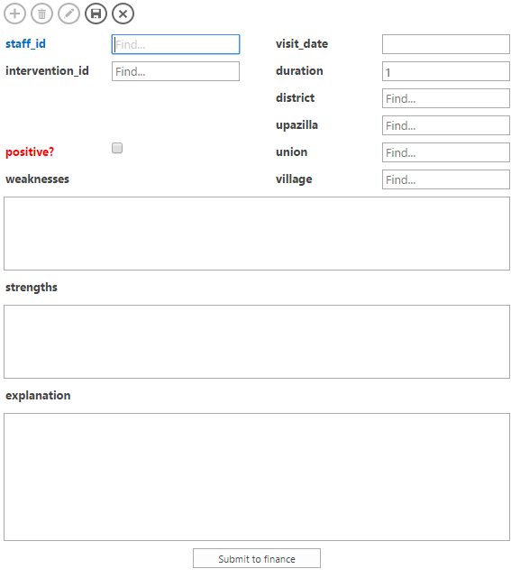

How to Gather Data Frequently…
Force employees to give their impressions (both quant & qual) after every field visit.
Gather info while it’s fresh!
Ensure a constant data stream

Slide 26
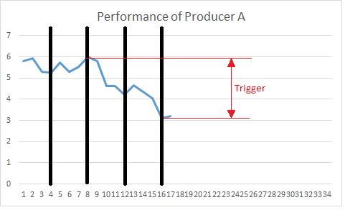
Actionable Data Points
Gather quantitative information from every producer
Pre-establish conditions that require attention, and link these to an action – Like emailing senior management
Run constant checks against the data, confident that actions will be taken when appropriate.

Slide 27
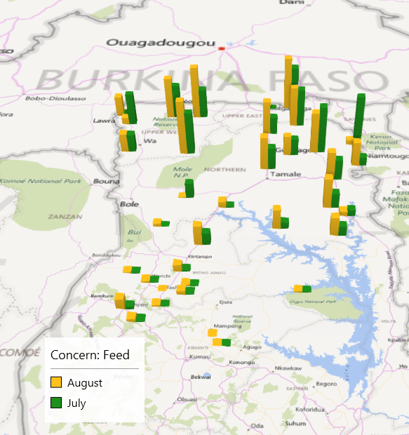
How to Do Adaptive Management
Analyze information regionally and address regionally relevant interventions
In this way, we don’t follow our plan, we respond to the field

Slide 28
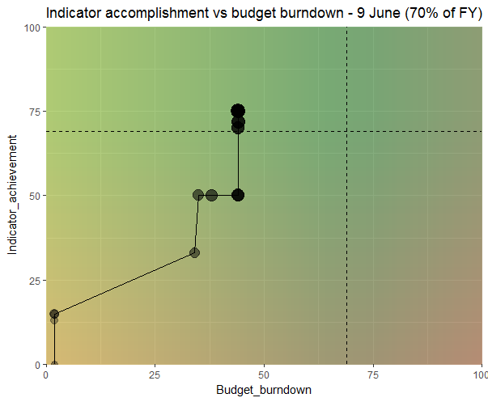
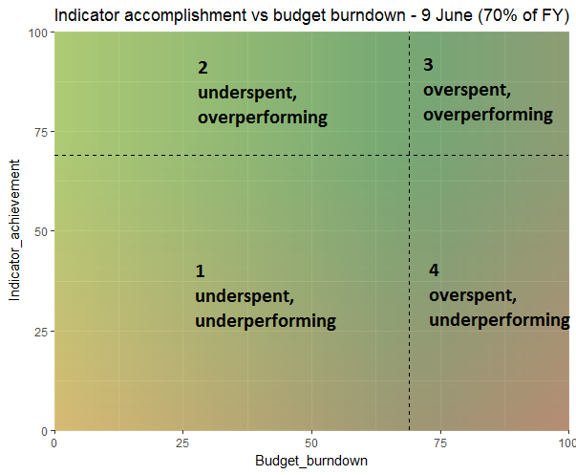
Example Integration: M&E and Finance

Slide 29
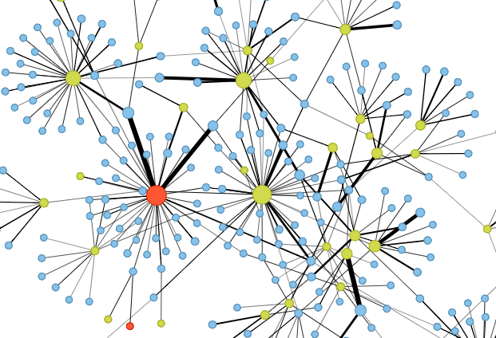
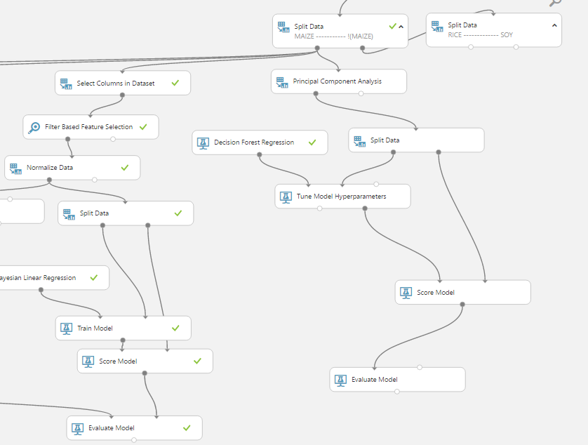
Examples of Advanced Analysis
Social Network analysis
Example: explore individual company progress as a function of network centrality, number of connections, etc.
https://github.com/ACDIVOCATech/easyNetworkMaker
Machine Learning
Advanced algorithms to measure attributions of many variables, and potentially for predictive analysis.
?
Structural
Equation
Modelling
Developing a model of models to validate our Theory of Change

Slide 30
Institutional Transformation
Lessons to Succeed in Global MERL Tech Deployment Initiatives

Slide 31
International Development–Time Allocation
The me I am
The me I want to be
The me donors* wish I was
Obtain and clean data
Obtain and clean data
Obtain and clean data
Calculate Indicators
Calculate Indicators
Calculate Indicators
Organize and store data
Explore and Learn!
Organize and store data
Explore and Learn!
Organize and store data
Explore and Learn!

Slide 32

Need to Change How to Invest Time
Obtain and clean data
Calculate Indicators
Organize and store data
Explore and Learn!
Never again!
Project Timeline
Project Timeline

Slide 33

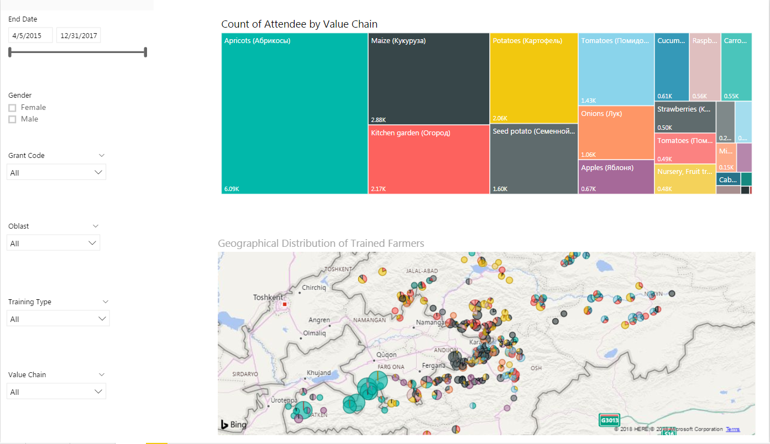
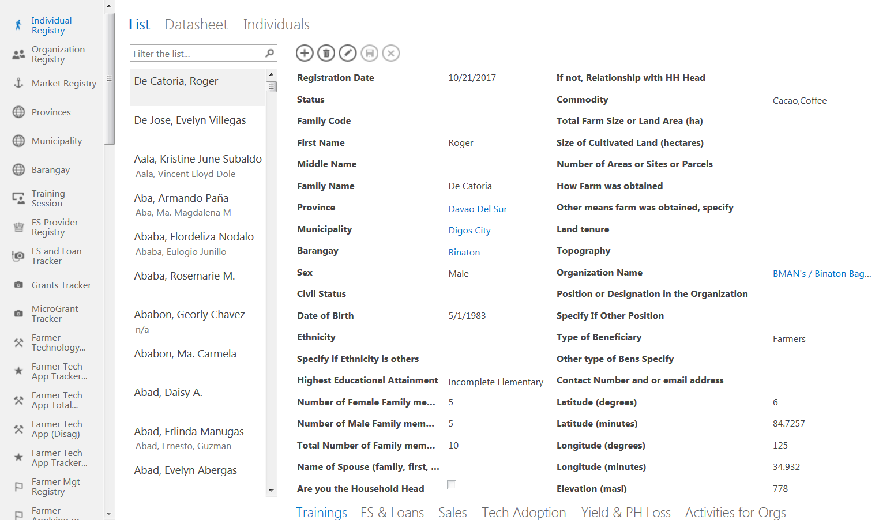

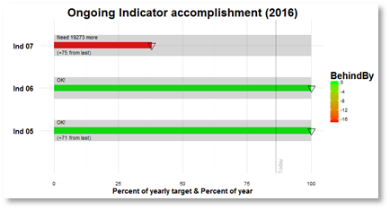

Robust tech solution = weeks/months of effort
Data/tech savvy culture = YEARS
Expect a Marathon Effort
Many employees will not adapt quickly. If the data-driven culture is not there, then even the most amazing tech solutions risk failure.

Slide 34
Pursue Maximum User Input
User needs assessment
Prototypes open to critique from wide audience
Pilot with enthusiasts first; use results to win over skeptics

Slide 35
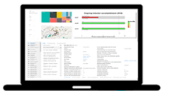

Too Much Too Fast Risks Disruption
It took 2 years to get my team to follow our current process… now you expect me to overhaul that?
Take this awesome tech now!
Planned Strategic Rollout Process
Focusing on new projects during their startup is most efficient.

Slide 36
Optimist View for MERL Data Initiatives
Many opportunities for real-time adaptive management and improved data analysis
Realist View
Improved analytics may give numbers that are not what you were hoping

Slide 37
Thank you!
We envision a world in which people are
empowered to succeed in the global economy.
www.acdivoca.org
Amit Kohli – akohli@acdivoca.org

